Slide 1

Geometry
Unit 5, Lesson 6 Proving Triangles Congruent Volume 1, pg. 252

Slide 2


Benchmarks
MA.912.GR.1.2
Prove triangle congruence or similarity using Side-Side-Side, Side-Angle-Side, Angle-Side-Angle, Angle-Angle-Side, Angle-Angle, and Hypotenuse-Leg.
MA.912.LT.4.10
Judge the validity of arguments and give counterexamples to disprove statements.
volume 1, pg. 252

Slide 3
Integrated Mathematical Thinking and Reasoning Standards
MA.K12.MTR.1.1 Actively participate in effortful learning both individually and collectively.
MA.K12.MTR.4.1 Engage in discussions that reflect on the mathematical thinking of self and others.
MA.K12.MTR.5.1 Use patterns and structure to help understand and connect mathematical concepts.
volume 1, pg. 252

Slide 4

Learning Target
I can prove two triangles are congruent using SSS, SAS, ASA, AAS, or HL congruence.
volume 1, pg. 252

Slide 5

Warm-Up
volume 1, pg. 253

Slide 6
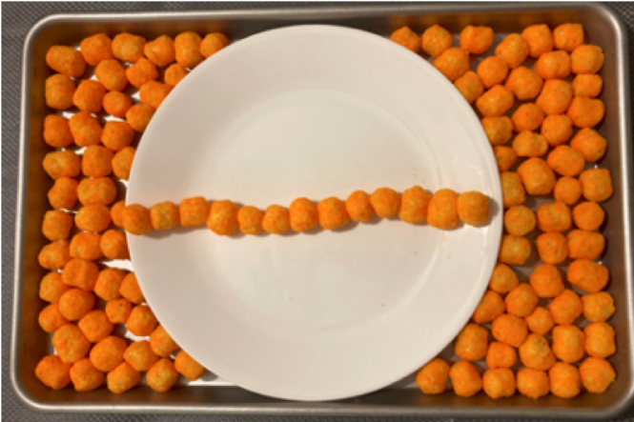
5.6.1 Warm-Up: Cheese Balls
The image shows cheese balls arranged on a baking sheet with a white plate on top. There are thirteen cheese balls on the plate.
Estimate how many cheese balls will fit on the plate.
Explain how you determined your estimate.
volume 1, pg. 253

Slide 7

Guided Instruction
volume 1, pg. 253

Slide 8
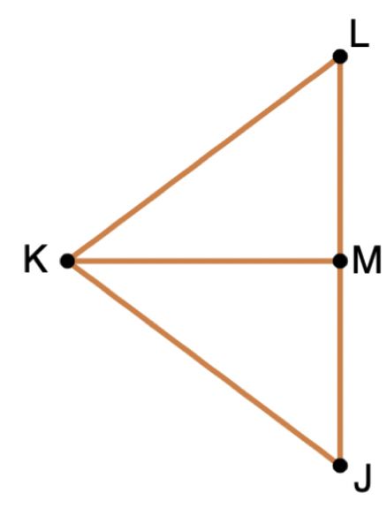
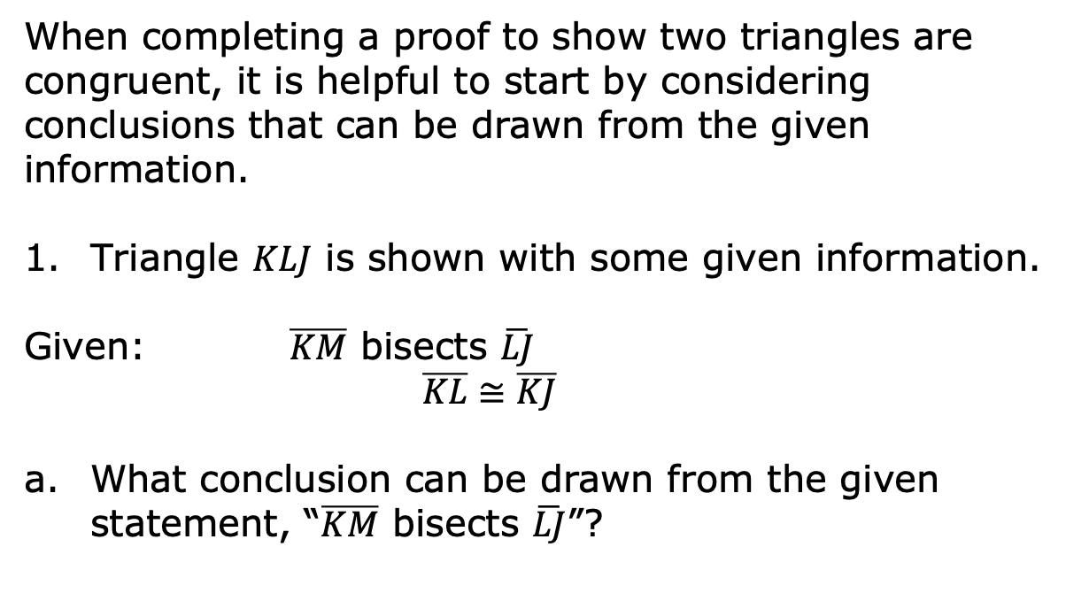
5.6.2 Guided Instruction: Proving Triangles Congruent
When completing a proof to show two triangles are congruent, it is helpful to start by considering conclusions that can be drawn from the given information.
Triangle $KLJ$ is shown with some given information.
Given: $\overline{KM}$ bisects $\overline{LJ}$
$\overline{KL}≅\overline{KJ}$
What conclusion can be drawn from the given statement, “$\overline{KM}$ bisects $\overline{LJ}$”?
volume 1, pg. 253

Slide 9
Explain why this conclusion can be drawn.
Mark the figure based on the given information.
What other conclusion(s) can be drawn from the information given?
volume 1, pg. 253

Slide 10
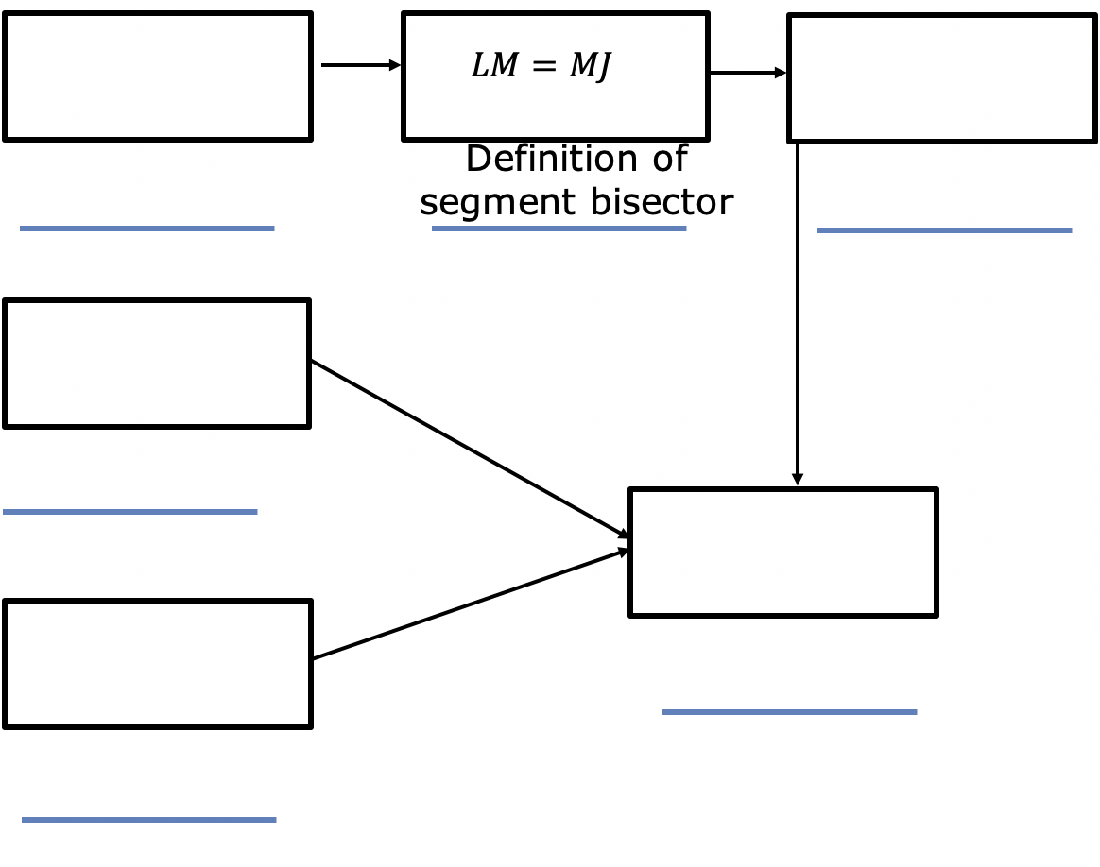
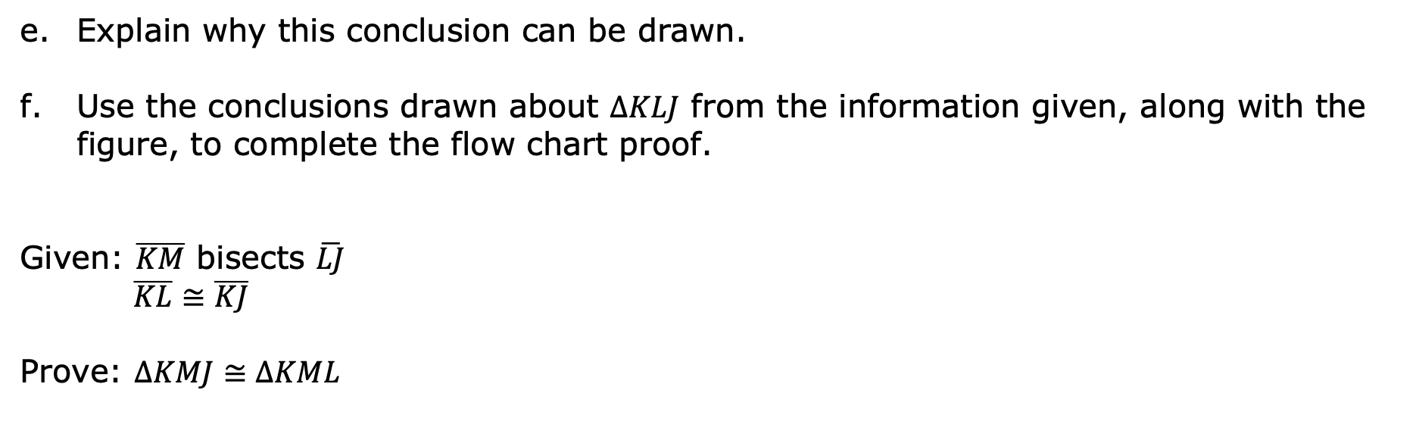
Explain why this conclusion can be drawn.
Use the conclusions drawn about $∆KLJ$ from the information given, along with the figure, to complete the flow chart proof.
Given: $\overline{KM}$ bisects $\overline{LJ}$
$\overline{KL}≅\overline{KJ}$
Prove: $∆KMJ≅∆KML$
volume 1, pg. 254

Slide 11
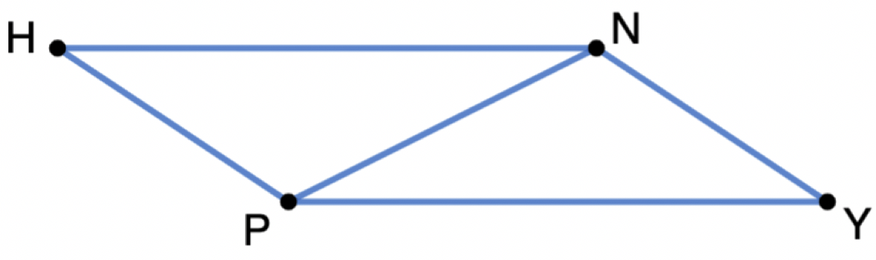
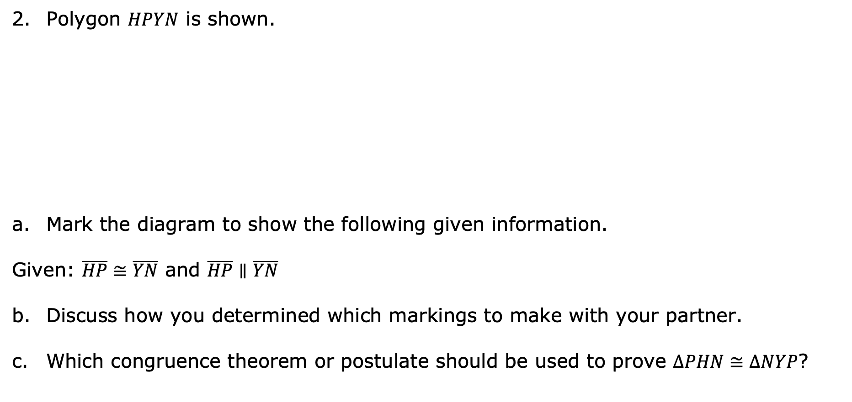
Polygon $HPYN$ is shown.
Mark the diagram to show the following given information.
Given: $\overline{HP}≅\overline{YN}$ and $\overline{HP}∥\overline{YN}$
Discuss how you determined which markings to make with your partner.
Which congruence theorem or postulate should be used to prove $∆PHN≅∆NYP$?
volume 1, pg. 254

Slide 12
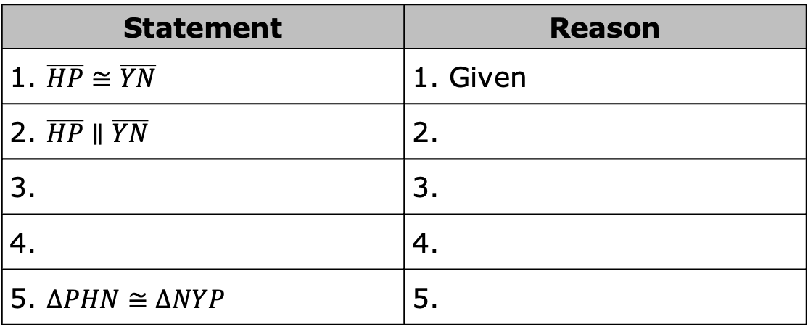
Complete the two-column proof.
Statement | Reason
1. $\overline{HP}≅\overline{YN}$ | 1. Given
2. $\overline{HP}∥\overline{YN}$ | 2.
3. | 3.
4. | 4.
5. $∆PHN≅∆NYP$ | 5.
volume 1, pg. 254

Slide 13
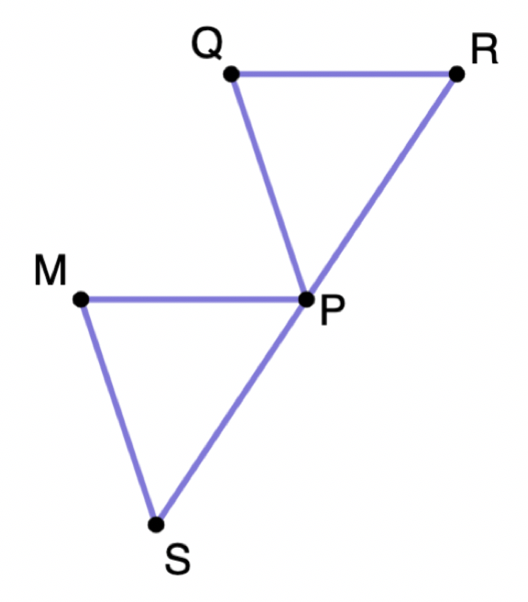
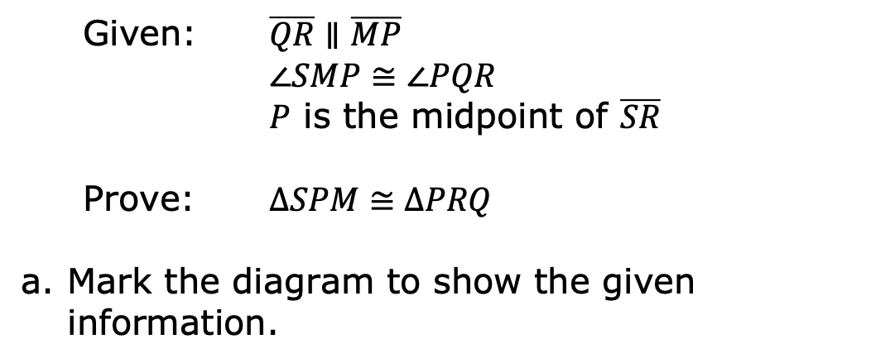
Triangles $MSP$ and $QPR$ are shown.
Given: $\overline{QR}∥\overline{MP}$
$∠SMP≅∠PQR$
$P$ is the midpoint of $\overline{SR}$
Prove: $∆SPM≅∆PRQ$
Mark the diagram to show the given information.
volume 1, pg. 255

Slide 14
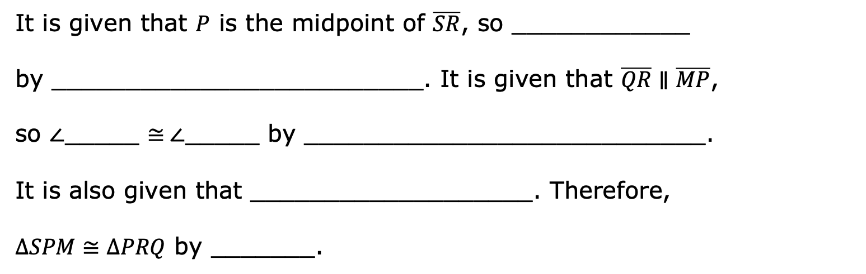
Complete the paragraph proof.
It is given that $P$ is the midpoint of $\overline{SR}$, so ____________
by _________________________. It is given that $\overline{QR}∥\overline{MP}$,
so $∠$_____ ≅$∠$_____ by ___________________________.
It is also given that ___________________. Therefore,
$∆SPM≅∆PRQ$ by _______.
volume 1, pg. 255

Slide 15

Guided Practice
volume 1, pg. 255

Slide 16

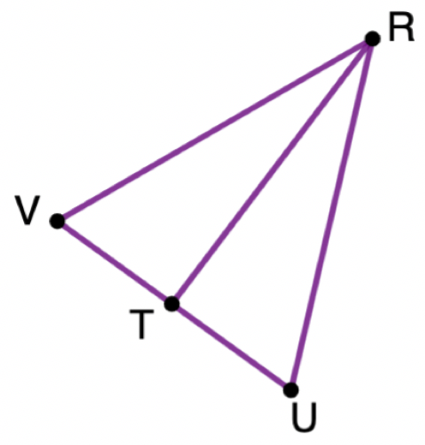
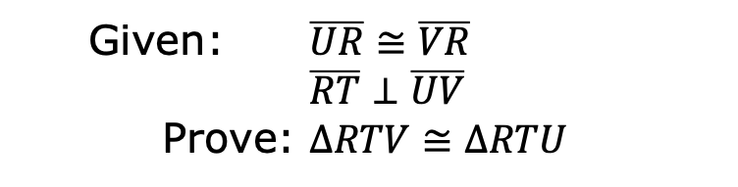
5.6.3 Guided Practice: Proving Triangles Congruent
Triangle $VRU$ is shown.
Given: $\overline{UR}≅\overline{VR}$
$\overline{RT}⊥\overline{UV}$
Prove: $∆RTV≅∆RTU$
volume 1, pg. 255

Slide 17
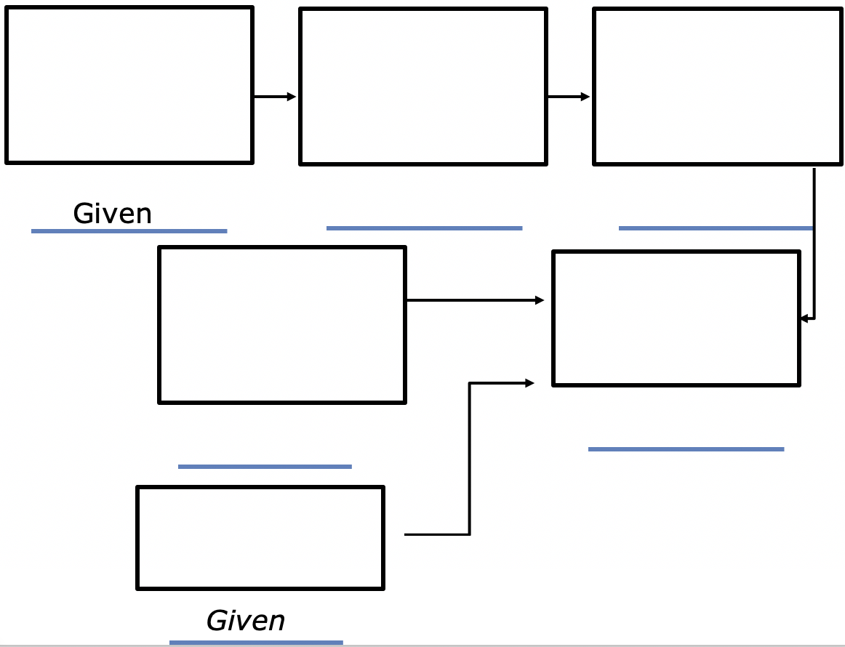
Complete the flow chart proof.
volume 1, pg. 255

Slide 18

Your Turn
volume 1, pg. 256

Slide 19
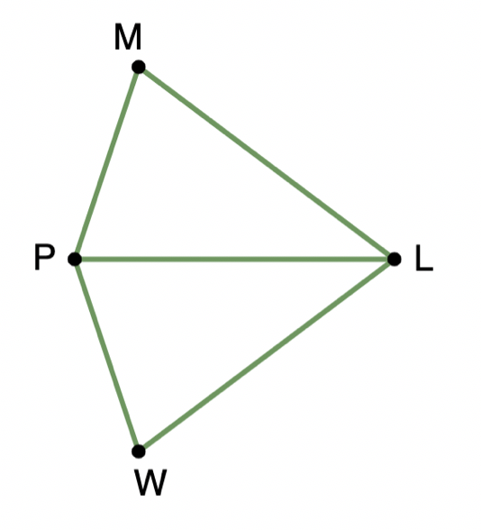
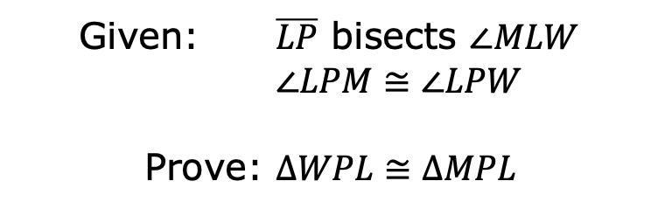
5.6.4 Your Turn!
Polygon $MLWP$ is shown.
Given: $\overline{LP}$ bisects $∠MLW$
$∠LPM≅∠LPW$
Prove: $∆WPL≅∆MPL$
volume 1, pg. 256

Slide 20
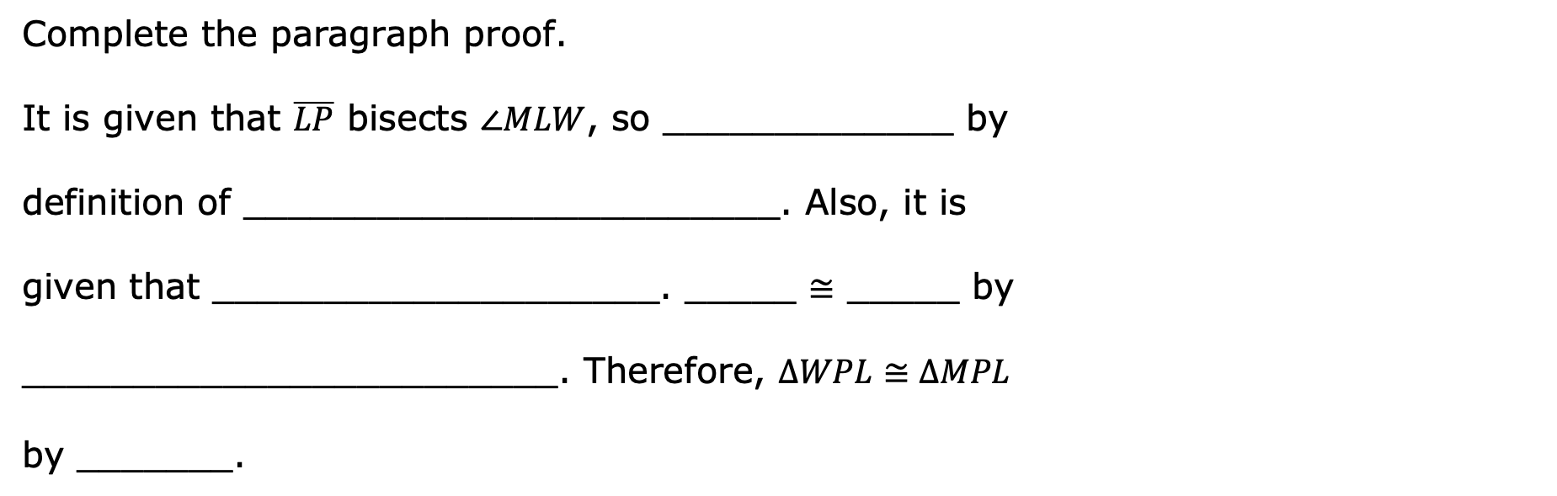
Complete the paragraph proof.
It is given that $\overline{LP}$ bisects $∠MLW$, so _____________ by
definition of ________________________. Also, it is
given that ____________________. _____ $≅$ _____ by
________________________. Therefore, $∆WPL≅∆MPL$
by _______.
volume 1, pg. 256

Slide 21

Wrap-Up
volume 1, pg. 256

Slide 22
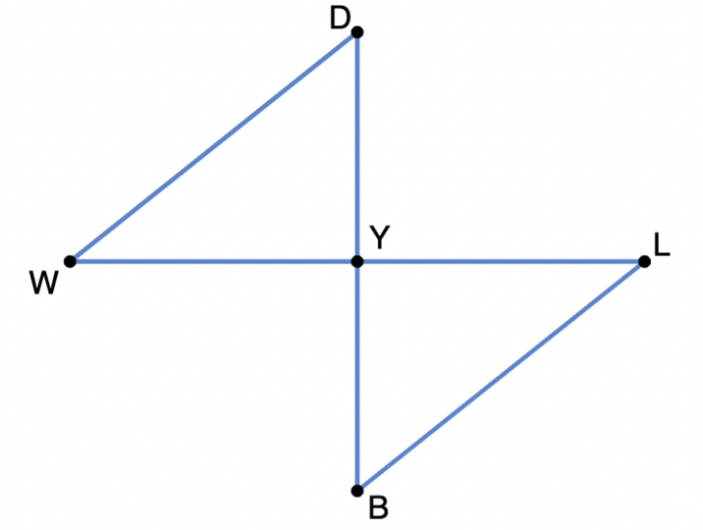
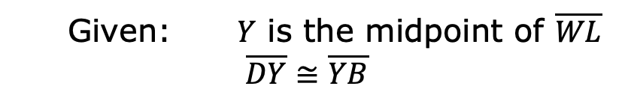
5.6.5 Wrap-Up: Error Analysis
The flow chart proof has two errors. Find the errors and correct them.
Given: $Y$ is the midpoint of $\overline{WL}$
$\overline{DY}≅\overline{YB}$
Prove: $∆DWY≅∆BLY$
volume 1, pg. 256

Slide 23
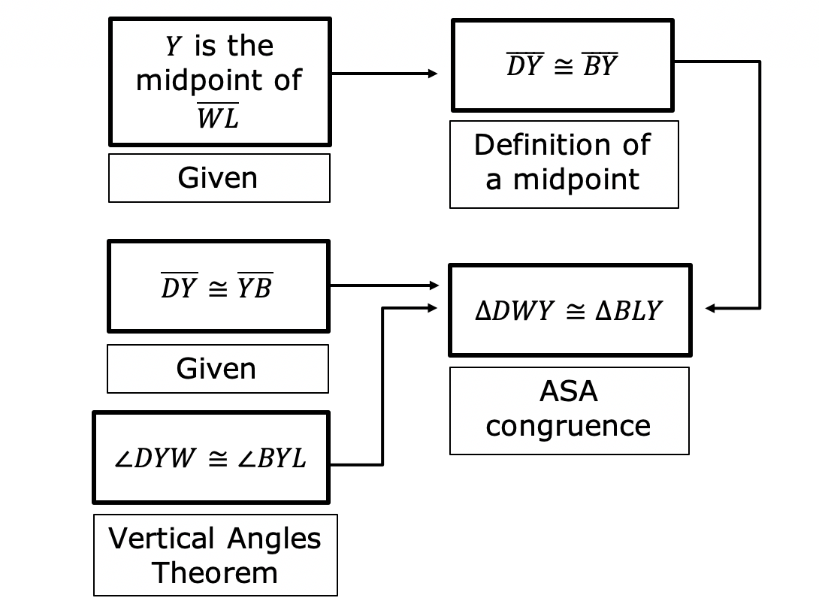
volume 1, pg. 256

